Slide 1
S20-65 Capstone Design: Music Sheet Maker
Sifan Yuan(sy609)
Haocong Wang(mw814)
Advisor: Prof. Yingying Chen
Instructor: Ph.D. Yilin Yang

Slide 2
Music Sheet Maker
Goal: Write mucis sheet automatically with a given part of the audio
Application: Web application
Music Sheet: Writen in Tablature

Slide 3
Motivation
Disadvantage of traditional handwriting music transcription
Difficulty in recording the rhyme that suddenly come into our mind
Find a way to let everyone be able to “write” music
by using computing skill

Slide 4
Introduction of Workflow
Play a short audio and record it into a wav file
Audio data fetching and analyzing
- In time-frequency domain
Based on the fetched data, create a MIDI for the audio
The MIDI file can be read by the computer

Slide 5
Approaches
What does a note represent?
-In music, different notes represent different pitches and different pitches represent different frequencies.
How is frequency connected to music sheet?
-In our algorithm, we recognize the pitch and how long this pitch lasts. With these two elements, we are able to create MIDI file.

Slide 6
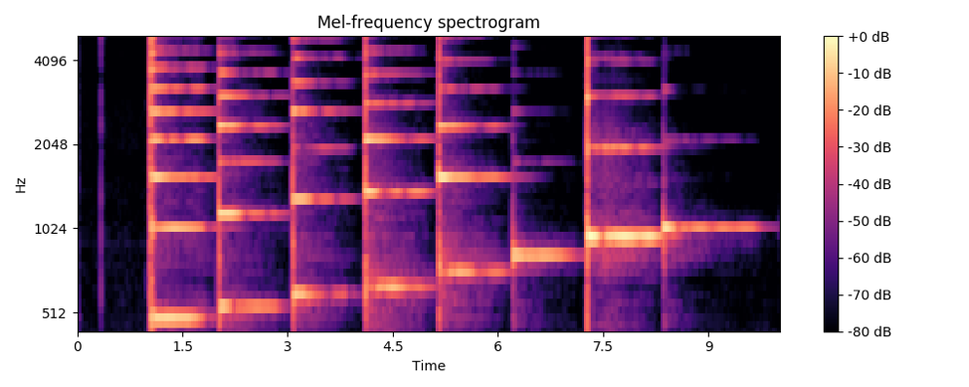
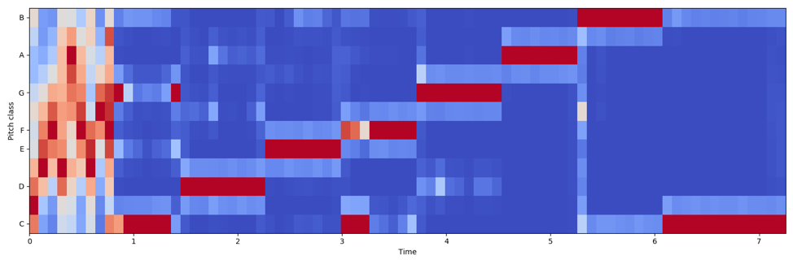
Approaches
Collect the data of one single octave and use it as the sample
For data analyzing part:
To change the data into a time-frequency domain, we use the algorithm of spectrogram and chroma gram to process the audio we get before.

Slide 7
Spectrogram & Chromagram
A spectrogram is a visual representation of the spectrum of frequencies of a signal as it varies with time.
Chroma-based features, which are also referred to as "pitch class profiles", are a powerful tool for analyzing music whose pitches can be meaningfully categorized (often into twelve categories).

Slide 8
Approaches:
We use the sliding window to do the analyzing work. We first find out the maximum window from the part we divided before. Then, we choose the maximum column from this window so that we can get the exact detail frequency of this part of radio, in a word, we get the exact octave of this single note.
After solving this problem, we can now transcript some simple music.

Slide 9
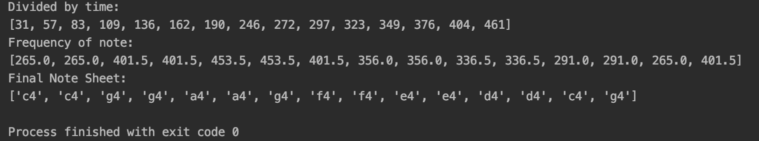
Approaches
By using these two kinds of data, we successfully divide the audio by every single note and can also label the note by different pitch. And now, we can write a MIDI.

Slide 10
MIDI
Musical Instrument Digital Interface
MIDI is a technical standard that describes a communications protocol, digital interface, and electrical connectors that connect a wide variety of electronic musical instruments, computers, and related audio devices for playing, editing and recording music
Music sheet that the computer can read and understand

Slide 11
Approaches
There are already several existing methods to write MIDI by hands:
-label the pitch and the lasting time for each note one by one
Our program do the labeling job automatically:
-The two matrix containing frequencies and time can be used directly to write a MIDI

Slide 12
Approaches
In our program, each pitch has its own serial number:
-With the frequencies we extracted in the previous step, we can find the number for each note in the audio.
Divided by time:
-With the time matrix extracted from the audio, we know the duration of each note.
Combine them together

Slide 13
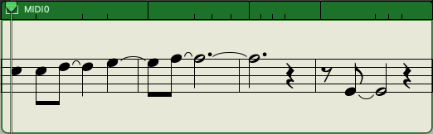
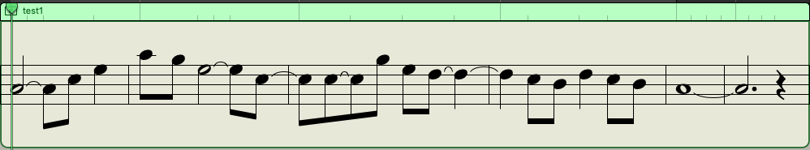
Results
These are two samples of the MIDI files we created. The second one is the one we recorded in our video. Our program works well on most cases.
Sometimes there are some errors. Most of them are the octave errors.

Slide 14
Future Work
More accurate and deal with complicated music:
-Right now there are still some mistakes in our program.
-Cannot deal with fast music
-Cannot deal with music with multiple voice parts
Recognize human voice:
-One of our motivation
Recognize different musical instruments

Slide 15
Thank You for Your Attention!
Sifan Yuan: sy609@scarletmail.rutgers.edu
Haocong Wang: mw814@scarletmail.rutgers.edu

